Slide 1


M.Tech/MCA Program
Advanced Industry Integrated Programs
Jointly offered by University and LTIMindTree
Review III
AI Voyage Panner-Context Aware Travel Recommendations and Adaptive Scheduling
Team member
Syed Ali Fathima
T9957
Knowledge partner | Implementation partner

Slide 2
Project Title - Calibri body 18
Introduction
Planning a trip manually requires searching multiple sources for destinations, attractions, restaurants, hotels, weather, and routes.
Generic travel plans may not consider the user's budget, interests, travel dates, number of travelers, and food preferences.
AI Voyage Planner uses Generative AI, RAG, and live location-based APIs to create personalized travel plans.
The system integrates Geoapify, OpenWeather, and route information to provide dynamic travel recommendations.
A React frontend and FastAPI backend are used to provide an interactive travel planning platform.
The system aims to make travel planning personalized, structured, and data-driven.

Slide 3
Project Title - Calibri body 18
Objective
To develop an AI-based personalized travel planning system.
To generate day-wise itineraries based on destination, duration, budget, interests, and number of travelers.
To retrieve real-world tourist places and restaurants using Geoapify APIs.
To provide weather information using the OpenWeather API.
To generate route information between the origin and destination.
To recommend hotels, restaurants, attractions, and local places.
To dynamically replan the itinerary based on changing user requirements.
To provide a user-friendly web interface using React and FastAPI.

Slide 4
Project Title - Calibri body 18
Module name
S.No | Module Name | Description
1 | User Input | Accepts origin, destination, dates, travelers, budget and interests
2 | Destination Processing | Identifies and processes the selected destination
3 | Live Places Retrieval | Retrieves real tourist places using Geoapify
4 | Restaurant Recommendation | Provides breakfast, lunch and dinner recommendations
5 | Weather Information | Retrieves destination weather information
6 | Route Planning | Calculates route and distance between origin and destination
7 | Smart Itinerary Generation | Creates morning, afternoon and evening activities
8 | Hotel & Local Place Recommendation | Displays available hotels and local places

Slide 5
Project Title - Calibri body 18
Problem Statement
Travel planning requires information from multiple platforms.
Users need to manually compare destinations, attractions, restaurants, hotels and transportation.
Existing travel planners often provide generic itineraries instead of highly personalized plans.
Static travel plans cannot easily adapt when user requirements change.
Live information such as weather, routes and nearby places must be obtained from external sources.
Therefore, there is a need for an AI-powered travel planner that combines personalization, retrieval, live APIs and dynamic itinerary generation.

Slide 6
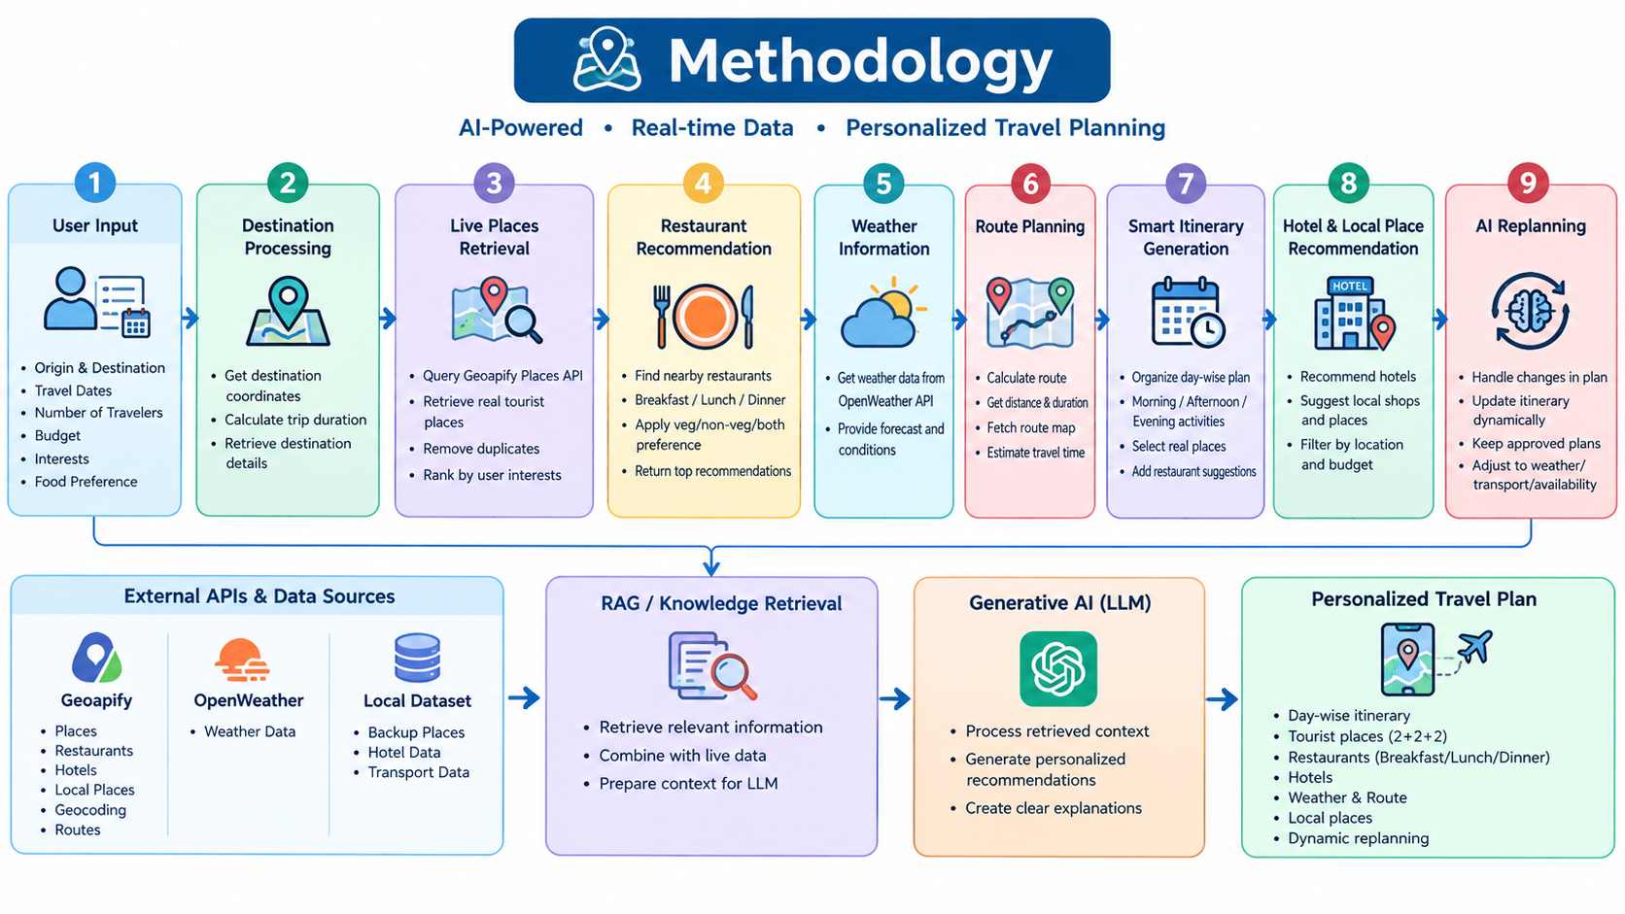
Project Title - Calibri body 18
Methodology

Slide 7
Project Title - Calibri body 18
Algorithms
Step | Process | Description
1 | User Input | Collect origin, destination, travel dates, number of travelers, budget, interests and food preference.
2 | Trip Preprocessing | Validate trip details and calculate the trip duration.
3 | Live Data Retrieval | Retrieve real tourist places, restaurants, hotels and local places using Geoapify API.
4 | Knowledge Retrieval | Retrieve relevant information from the available dataset / RAG knowledge base.
5 | Context Formation | Combine retrieved knowledge with live API data and user preferences.

Slide 8
Project Title - Calibri body 18
Algorithms
Step | Stage | Process
6 | Generative AI Processing | Process the retrieved context using the LLM to generate personalized recommendations.
7 | Smart Itinerary Generation | Generate a day-wise itinerary with morning, afternoon and evening activities.
8 | Recommendation Integration | Add restaurants, hotels, local places, weather information and route details.
9 | Dynamic Replanning | Dynamic Replanning.

Slide 9
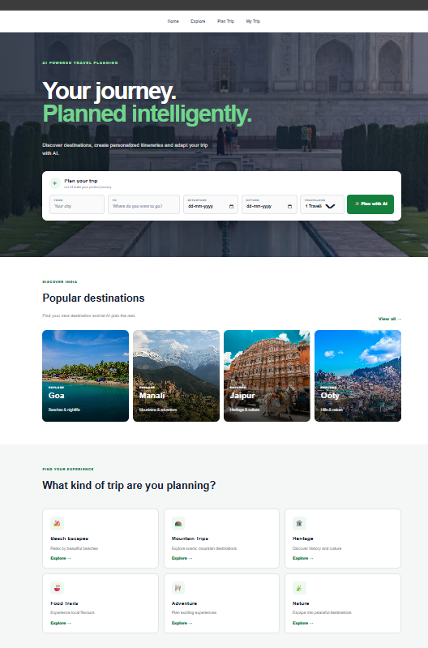
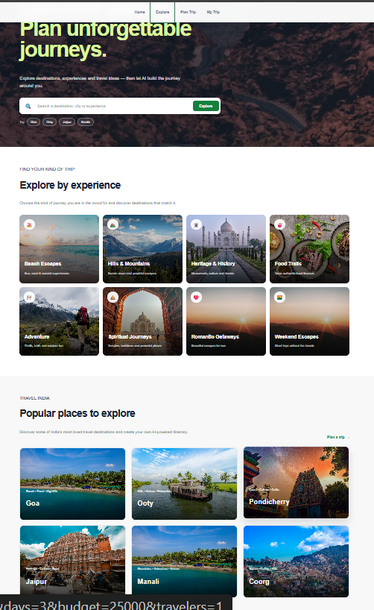
Project Title - Calibri body 18
Findings and Results

Slide 10
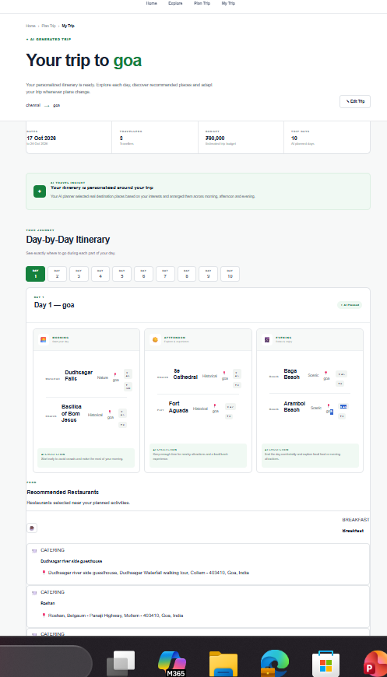
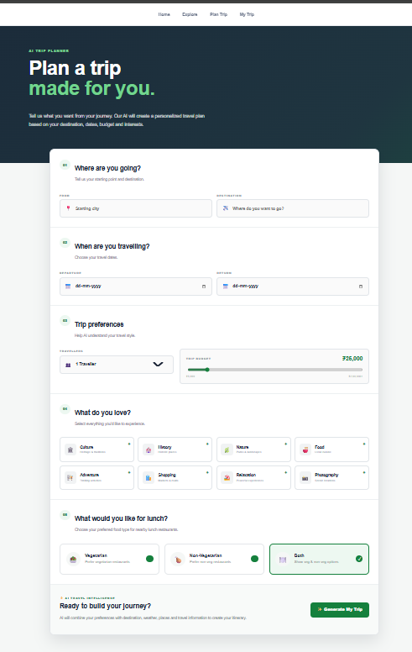
Project Title - Calibri body 18
Findings and Results

Slide 11
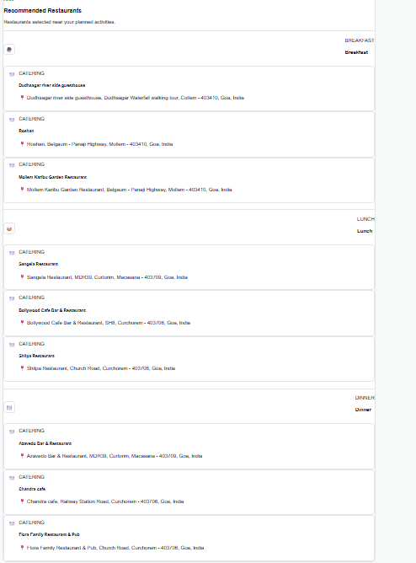
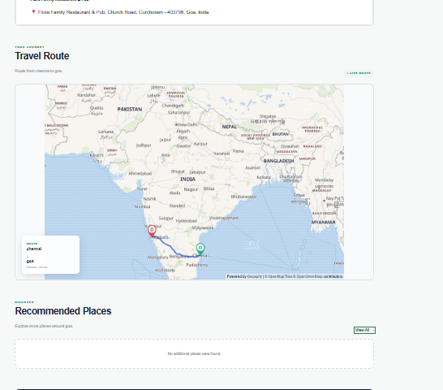
Project Title - Calibri body 18
Findings and Results

Slide 12
Project Title - Calibri body 18
Conclusion
The AI Voyage Planner provides an intelligent and personalized approach to travel planning by combining Generative AI, Retrieval-Augmented Generation (RAG), and real-time travel data. The system uses user preferences such as destination, travel dates, budget, interests, number of travelers, and food preferences to generate customized day-wise itineraries. By integrating Geoapify for places, restaurants, hotels and route information and OpenWeather for weather details, the system provides practical and relevant travel recommendations. The smart itinerary module organizes activities into morning, afternoon, and evening schedules, while the dynamic replanning feature allows the itinerary to be updated according to changing travel conditions and user requirements. Overall, the proposed system reduces the complexity of manual travel planning and provides a flexible, personalized, and intelligent travel experience.

Slide 13
Project Title - Calibri body 18
Acknowledgement
I sincerely thank LTM and L&T EduTech for providing the infrastructure, laptop, training room, ID card, and a valuable 2-month opportunity to enhance my technical skills through practical project development.
I express my special gratitude to Dr. Ganesh for his continuous guidance, valuable suggestions, and support in improving my project. I also thank the Classroom Managers for their daily monitoring, coordination, and assistance in resolving issues. Finally, my special thanks to Mr. Jayakanthan, Manager – Delivery Operations, L&T EduTech, for his encouragement, support, and for providing this valuable opportunity.

Slide 14
Project Title - Calibri body 18
Reference
[1] H. Zheng et al., “Recommender Systems in the Era of Large Language Models (LLMs),” IEEE Transactions on Knowledge and Data Engineering, vol. 36, no. 11, pp. 6889–6907, Nov. 2024, doi: 10.1109/TKDE.2024.3392335.
[2] “Travel Itinerary Generation using AI and Recommendation Systems,” in Proc. IEEE Conf., 2025.
[3] “Smart Trip Planner for Personalized Tourism Itineraries,” in Proc. 5th Int. Conf. on Ubiquitous Computing and Intelligent Information Systems (ICUIS), 2025, doi: 10.1109/ICUIS67429.2025.11380545.
[4] “Genetic Algorithm Based Personalized Travel Recommendation System,” in Proc. 2nd Int. Conf. on Intelligent Data Communication Technologies and Internet of Things (IDCIoT), 2024, doi: 10.1109/IDCIoT59759.2024.10467470.
[5] “Evaluation of the Effect of Tourism Recommendation System based on AI,” in Proc. 3rd Int. Conf. on Artificial Intelligence and Computer Information Technology (AICIT), 2024, doi: 10.1109/AICIT62434.2024.10730422.

